Slide 1


Slide 2
Session outcomes
Participants should be able to:
Share experiences about the features of an Activity of Integration
prepare and score an activity of integration

Slide 3
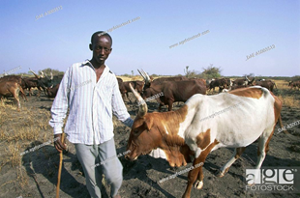
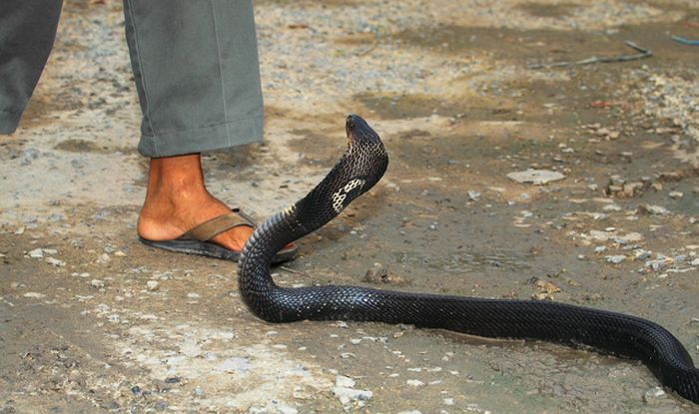
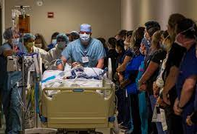
Activity 1: Activity of Integration – Introduction to Biology (20 Mins).
During dry seasons, Kamuntu goes to the nearby national park to graze his animals. One day as he was grazing his animals, a snake bit him. He ran to a local traditional healer who used herbs and a Blackstone but this couldn’t help. By the time he was taken to the hospital for treatment, he was breathing fast, sweating and his eyes were half closed. However, he was able to describe the snake and this helped the wildlife authorities identify it. The information about the type of snake helped the doctors to know what treatment to use.
Assuming you are a biology journalist whose task is to raise awareness among your schoolmates about the subject, write a detailed article analyzing the different aspects of the story about Kamuntu.

Slide 4
Activity 2: (3 minutes)
In groups, brainstorm on the following:
What is meant by an activity of integration?
How is the activity of integration used in teaching and learning?
As a practicing teacher, where can you get the activities of integration to assess learners?

Slide 5
THE NEW CURRICULUM FOCUS
COMPETENCY BASED
PEDAGOGY OF INTEGRATION
APPLYING AND USING WHAT ONE HAS LEARNT/LEARNED WHEN FACED WITH CHALLENGES/PROBLEM SITUATION
COMPETENCY BASED ASSESSMENT THAT FOLLOWS CRITERION REFERENCED ASSESSMENT PRINCIPLES

Slide 6
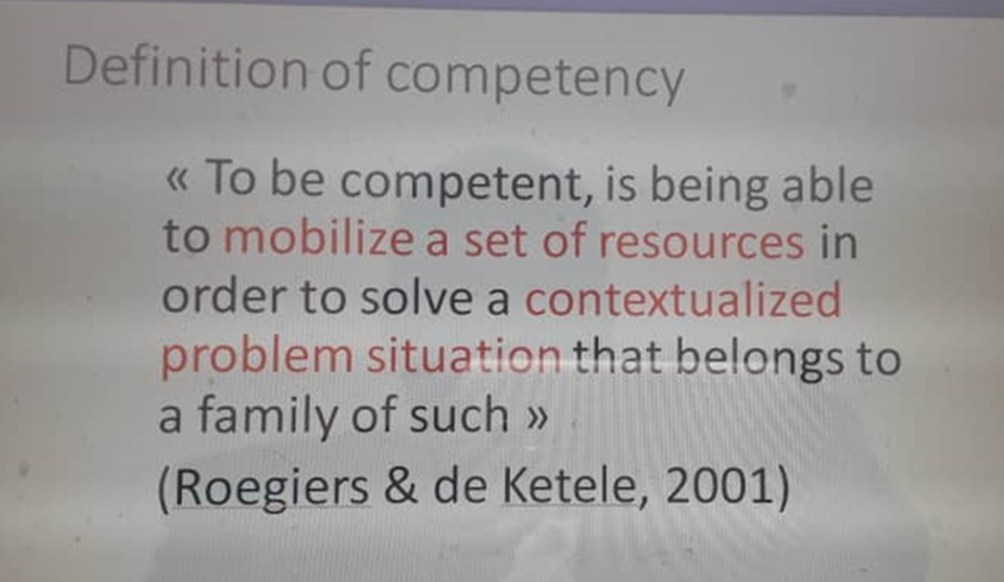
What is competency in this case?

Slide 7
WHAT IS PEDAGOGY OF INTEGRATION
PUTTING TOGETHER KNOWLEDGE, UNDERSTANDING, SKILLS, VALUES AND ATTITUDES AS A CONCEPT/CONSTRUCTS/COMPETENCY TO HANDLE REAL LIFE SITUATIONS

Slide 8
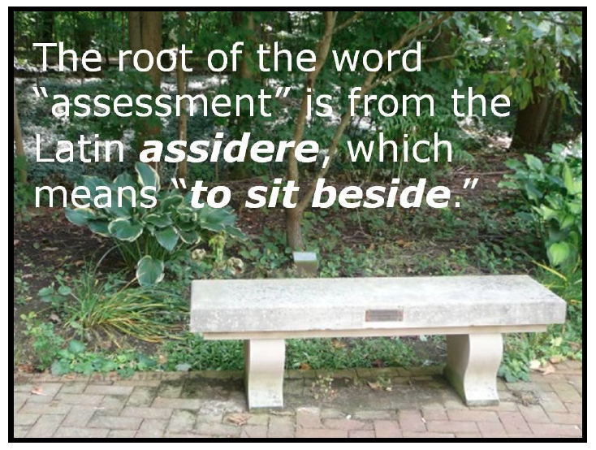
WHAT IS ASSESSMENT

Slide 9
WHAT IS ACTIVITY OF INTEGRATION?
THIS IS AN ASSESSMENT WHICH COMES AT THE END OF THE TOPIC
IT ASSESSES WHETHER THE LEARNER HAS MASTERED THE COMPETENCY OR NOT.
IT SHOWS HOW THE LEARNERS CAN INTEGRATE THE KNOWLEDGE , UNDERSTANDING, SKILLS, VALUES AND ATTITUDES OF THE COMPETENCY TAUGHT
IT HELPS LEARNERS TO APPLY AND USE THE KNOWLEDGE AND SKILLS ACQUIRED TO REAL LIFE SITUATION
IT MEASURES HOW LEARNERS MAKE DECISION WHEN FACED WITH A REAL-LIFE SITUATION/PROBLEM
IT MUST ASSESS HIGH ORDER THINKING SKILLS

Slide 10
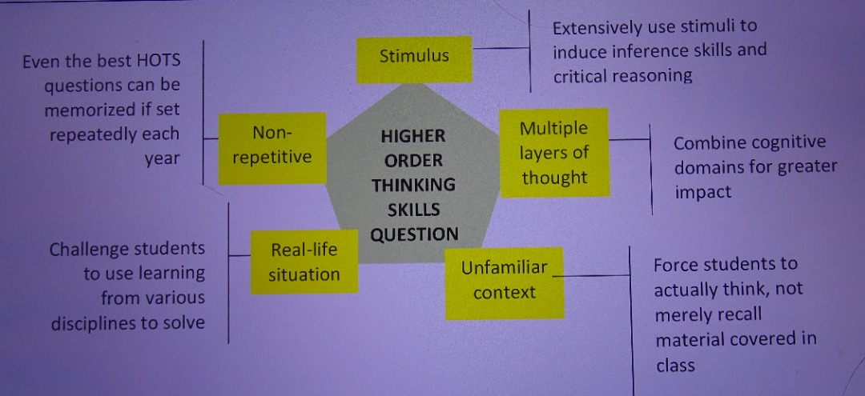
What HOT Questions entail in AoI

Slide 11
Key Points Continued
Activities of Integration (AoIs) combined in a term/year will contribute to End of Cycle assessment grade
Teachers can develop their own activities of integration.

Slide 12
Activity 3: (in 3 minutes)
With reference to Activity 1 above, in groups, identify the components of the AoI and the purpose each serves.
What are the characteristics of a good activity of integration?
What aspects do you take into consideration while designing an activity of integration?
Present your work to the plenary.

Slide 13

Components of the activity of Integration
The activity of integration has the following components.
Context/Problem/Scenario
Instruction with the Expected output
Support/Resources/materials

Slide 14
Significancy of the components
Components of AoI
Their significances components of AoI
Context/Problem/Scenario
Instruction with the Expected output
Support/Resources/materials
THIS IS AN ASSESSMENT WHICH COMES AT THE END OF THE TOPIC
IT ASSESSES WHETHER THE LEARNER HAS MASTERED THE COMPETENCY of the topic.
IT SHOWS HOW THE LEARNERS CAN INTEGRATE THE KNOWLEDGE , UNDERSTANDING, SKILLS, VALUES AND ATTITUDES OF THE COMPETENCY TAUGHT
IT HELPS LEARNERS TO APPLY AND USE THE KNOWLEDGE AND SKILLS ACQUIRED in REAL LIFE SITUATION
IT MEASURES HOW LEARNERS MAKE DECISION WHEN FACED WITH A REAL-LIFE SITUATION/PROBLEM
IT MUST ASSESS HIGH ORDER THINKING SKILLS

Slide 15
To design a good activity of integration,
identify the competencies that the scenarios will be designed to assess.
define the performance criteria actions that students will demonstrate in order to meet the competency e.g solving a problem using specific tools and techniques
identify the context in which the scenarios will be set. This may involve selecting real-life situations or creating fictional scenarios that allow students to apply the knowledge and skills they have learned. E.g. workplace setting or a training environment
The activity should be HOT (High Order Thinking) that requires critical thinking, innovativeness, problem solving ability of the learners

Slide 16
Activity 4: Scoring an activity of integration
In groups, using the assessment grid provided, score the responses to the activity of integration in Activity 1 .
Justify the scores you have awarded.
How relevant was the assessment grid in the scoring process?

Slide 17
Key points
Under the criterial reference assessment,
The evaluation grid is key for end of topic assessment of the learners because it sets standards that put the learners on uniform scale.
It is important to have a basis of evaluation for the Outputs that should be clear to the learners
The basis for evaluation can be one or more, depending on the output expected
For each output there must be description of learners achievement at the 3 levels in terms of relevance, accuracy and coherence
For each AoI the outstanding learner is described once in the Excellence column
The description of learner’s achievement is based on the Evaluation grid
The good grid is a set standard which every learner should measure to.

Slide 18
Activity 5:
Brainstorm
Describe the components of an assessment grid.
Share your experiences in using assessment grid.

Slide 19
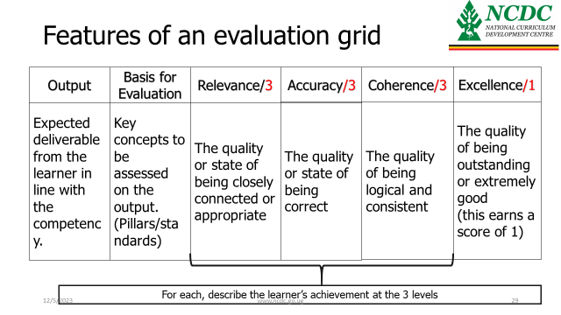
Assessment Grid

Slide 20
Activity 6:
In your subject groups, prepare an activity of integration for any topic in S2 and its evaluation grid
Through gallery walk, share your work with other group members to get their views on your work and share your views on their work too.

Slide 21

Thank You
https://www.exam-mate.com

